Slide 1
Parson’s Puzzle Library
COMS 3998
Spring 2019
Calvin Goah

Slide 2
Introduction
Parson’s Puzzle Game Creation
Identifying Bugs in SAGE Dev.
Field Testing

Slide 3
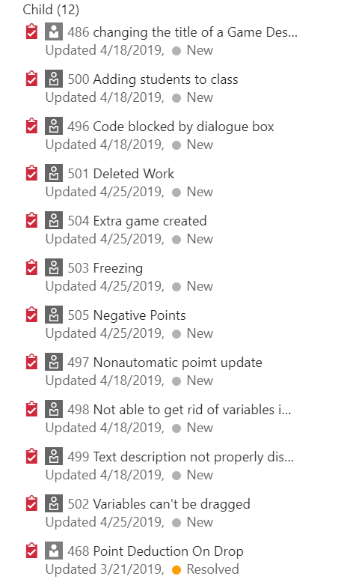
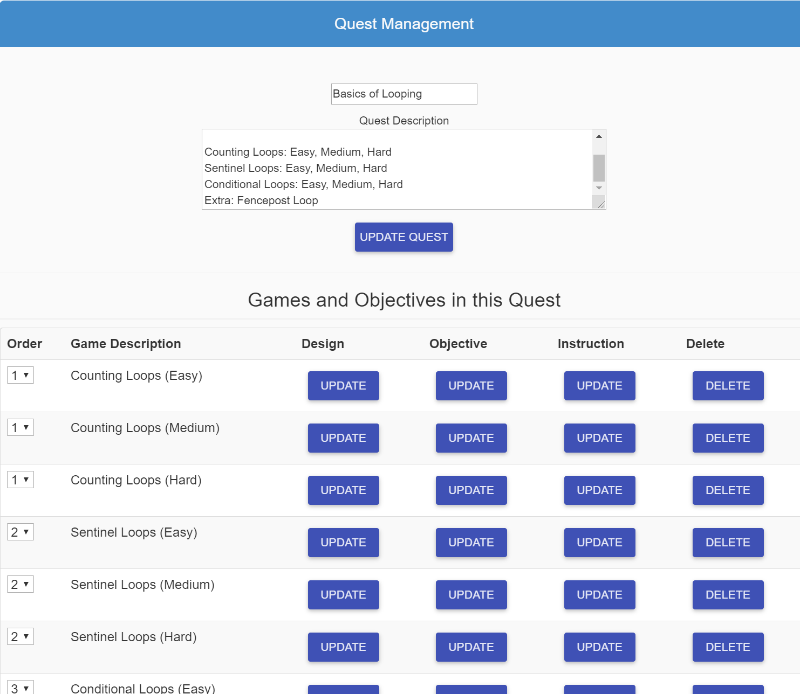
Introduction: Looping Games & Bugs

Slide 4
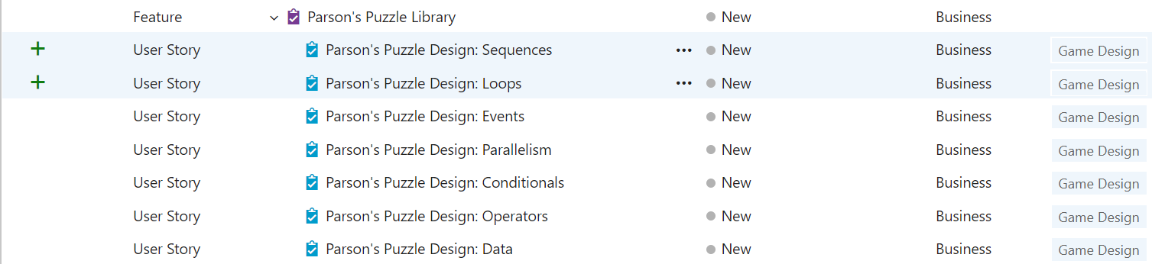
Background: Parson’s Puzzle

Slide 5
Design Concept Goals
Computational Thinking
Intuition Building
Fun

Slide 6
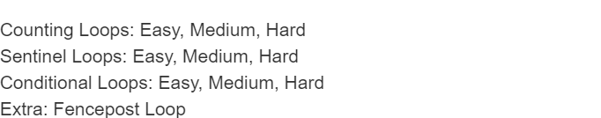
Design & Implementation of Looping Concepts

Slide 7
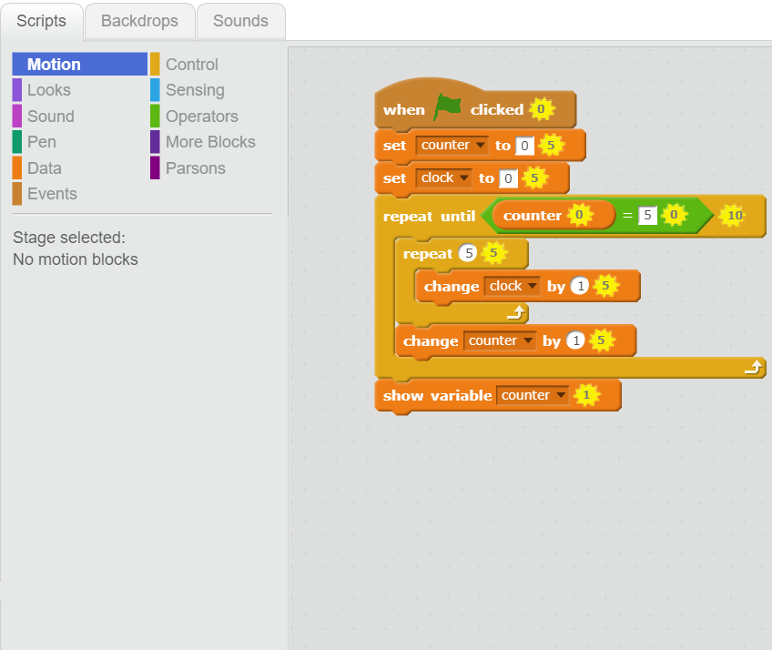
Counting Loops

Slide 8
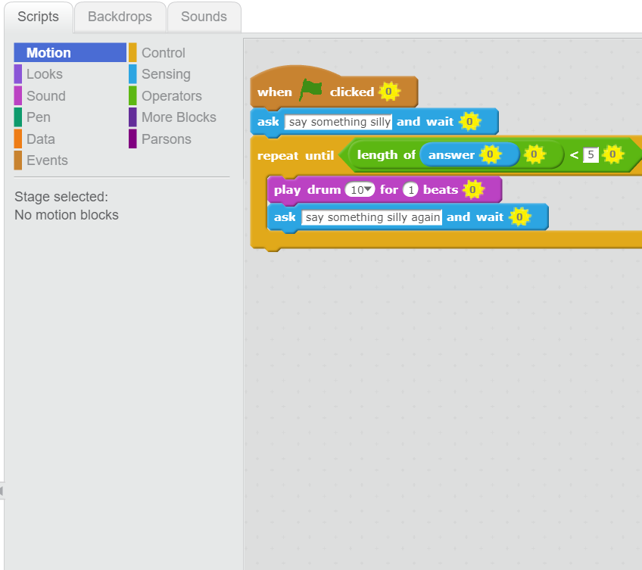
Sentinel Loops

Slide 9
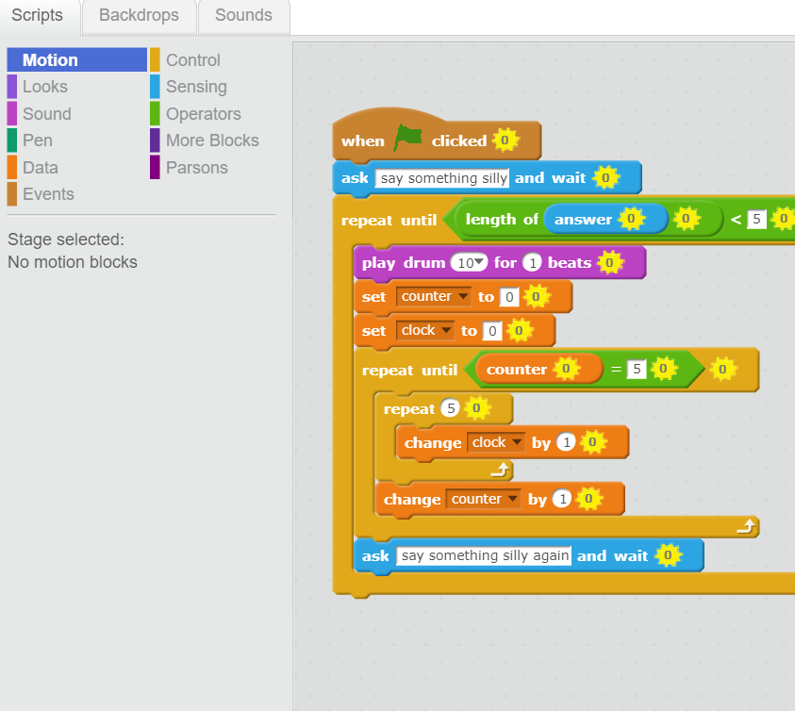
Conditional Loops

Slide 10
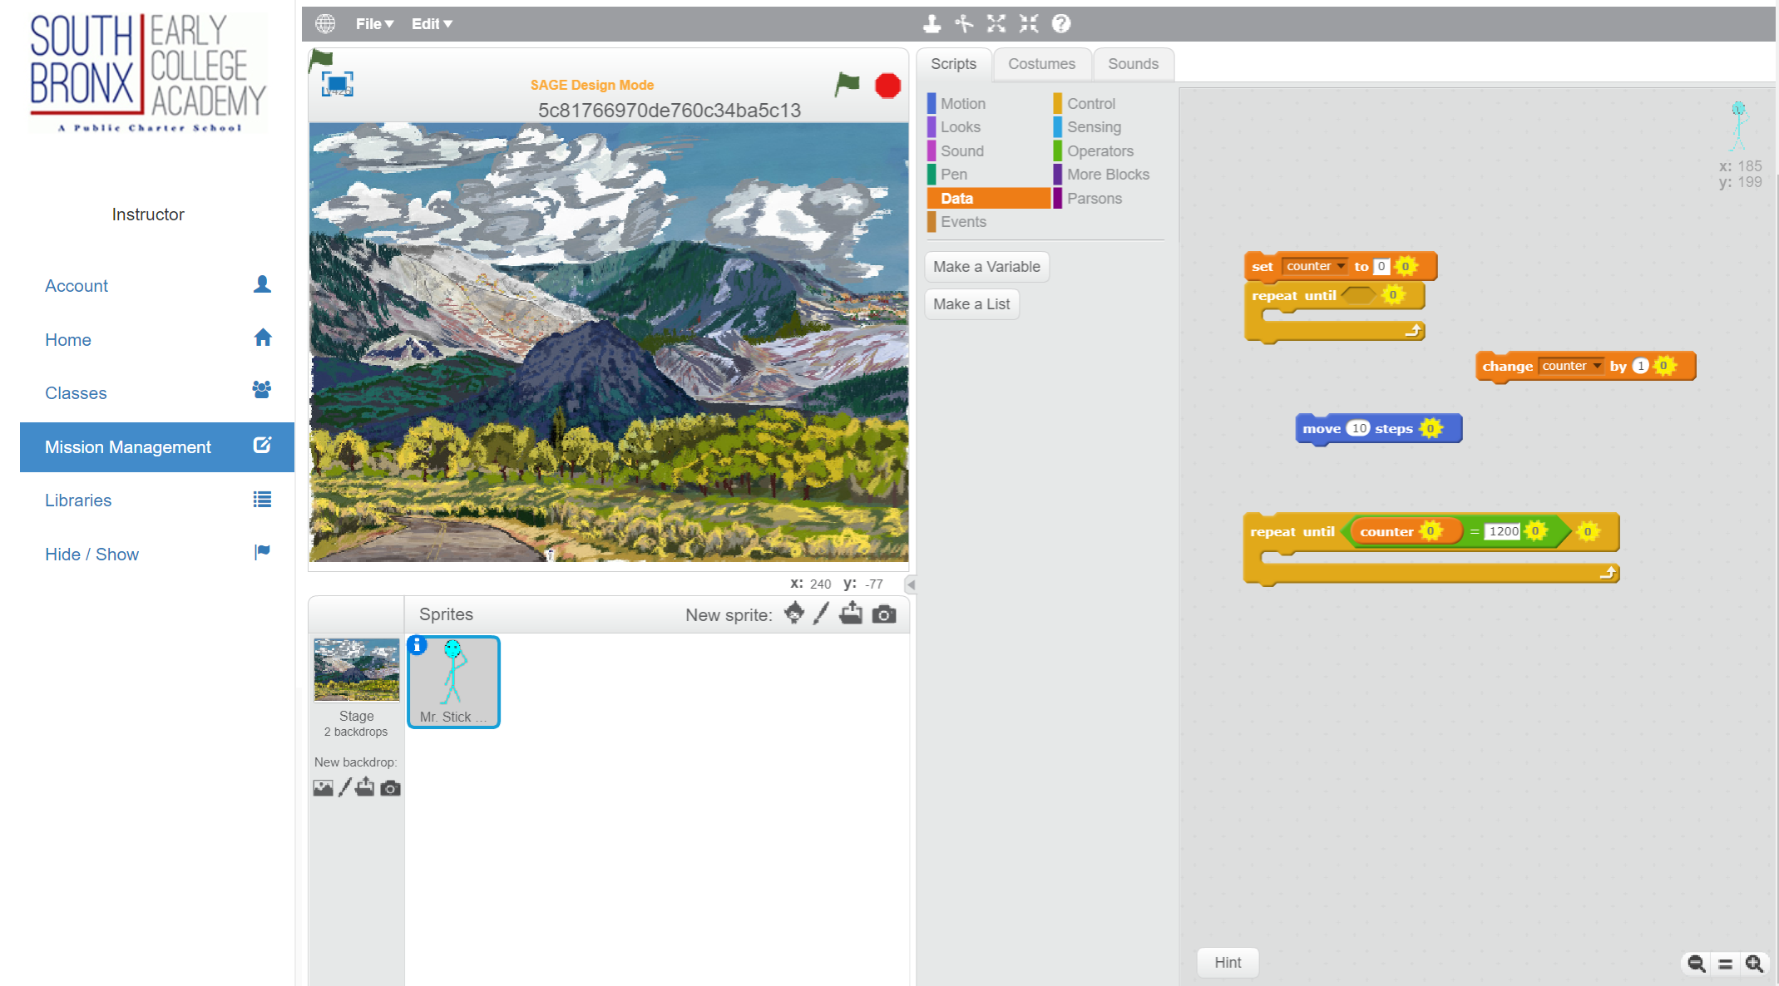
Issues/ Challenges

Slide 11
Demo

Slide 12
Field Testing: PS76
5th & 6th Grade Students

Slide 13
Student Questions
1. What grade are you in?
2. Did you understand the games?
3. What did you learn/understand?
4. What would make the games easier to understand?
5. Would you play this game for fun, why/why not?

Slide 14
Teacher Questions
https://docs.google.com/forms/d/e/1FAIpQLScPpmpYqgM6mSfO5n_hEsYXI0JGmFhDCuGx9EvxUXK4ZnS_tg/viewform

Slide 15
Future Work
Other Games
More developed Games
Field Testing
Illustration

Slide 16
Thank You!

Slide 17
References
http://chortle.ccsu.edu/assemblytutorial/Chapter-18/ass18_10.html
https://dl.acm.org/citation.cfm?id=2401798

